Slide 1


SUBJECT CODE
TYPE THE SUBJECT NAME HERE
VLSI IMPLEMENTATION IN HARDWARE SECURITY MODULE BASED ON AES ENCRYPTION METHOD
DATE : 16-04-2024
BATCH NUMBER : C10
PROJECT CODE :
BATCH MEMBERS : A.Akash
P.Jaiganesh
M.Mahizhan
SUPERVISOR : Mr.K.Srinivasan
SDG GOALS : 9
IV
VIII
20ECPJ801
Project Phase - II

Slide 2




20ECPJ801
220ECPJ801-PP2
JUSTIFICATION FOR SDG & SAP
SDG Goal : Industry, Innovation and Infrastructure
SAP Indicator: 9 Support domestic technology development, research and innovation in developing countries, including by ensuring a conducive policy environment for, inter alia, industrial diversification and value addition to commodities.
2

Slide 3

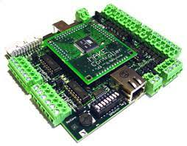

20ECPJ801
220ECPJ801-PP2
PROBLEM STATEMENT
To enhance system security, we would Deploy our adaption of AES encryption to fortify the hardware security module's security in a Network Centric Warfare Ecosystem.
A HSM(Hardware Security Module) chip is embedded in a Microcontroller of a System.

Slide 4
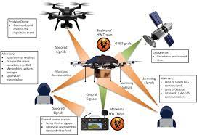
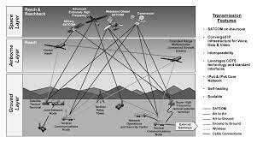
20ECPJ801
220ECPJ801-PP2
OBJECTIVE OF THE PROJECT
Security is becoming a crucial component of contemporary warfare.
Cyberattacks account for the majority of attacks. Cyberattack against Systems, Aircraft, Drones, and other Military Equipment, etc.
These seriously harm a nation's collateral. In order to achieve our goal of improving system security, we would use our adaptation of AES encryption to strengthen the security of the hardware security module, which is an HSM (Hardware Security Module) chip implanted in the system controller.

Slide 5
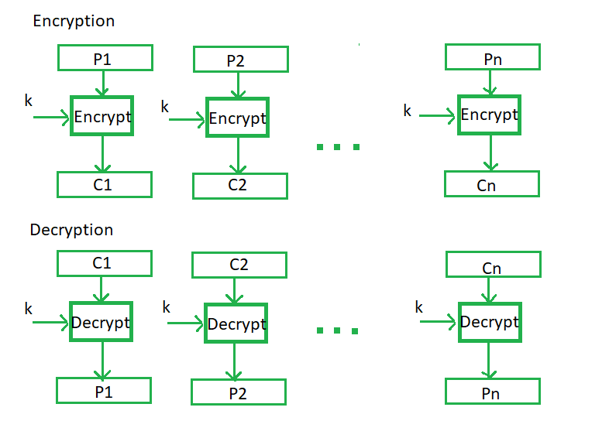
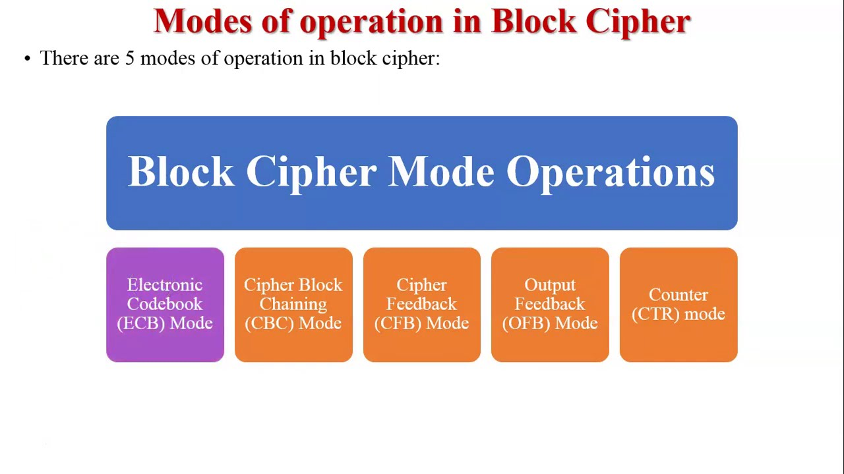
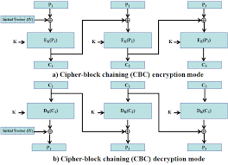
20ECPJ801
220ECPJ801-PP2
METHODLOGY
We would examine the most recent version of AES encryption first, modify it to reach the algorithm's optimum efficiency, and then implement it in a Hardware Security Module.
After that We would implement into a Controller for further study of the Security of the Controller System.
2

Slide 6
20ECPJ801
220ECPJ801-PP2
ROLES AND RESPONSIBILITIES
1)Mahizhan M
Role: Team Leader
Responsible for Coding and Testing in Project Development
2)Jaiganesh P
Role : Team Member
Responsible for Documentation of the Project , Implementation in Hardware security Module & study about the Business aspect of the Project
3)Akash A
Role : Team Member
Responsible for researching literature on projects comparable to ours, studying various algorithms related to our project, and assisting with the project's coding
2

Slide 7
20ECPJ801
220ECPJ801-PP2
LITERATURE REVIEW
S.no | Journal details And Year | Authors and title of the paper | Inference
1 | Journal of Electrical Systems and Information Technology 2 (2022) 178–183 | Power efficient and high performance VLSI architecture for AES algorithm K. Kalaiselvi a,∗, H. Mangalam | Advanced encryption standard(AES) algorithm has been widely deployed in cryptographic applications. This work proposes a low power and high throughput implementation of AES algorithm using key expansion approach.
2

Slide 8
20ECPJ801
220ECPJ801-PP2
S.no | Journal details And Year | Authors and title of the paper | Inference
2 | IEEE 2021 | VLSI IMPLEMENTATION OF AES ALGORITHM SAURABH KUMAR | This paper presents In the past cryptography means only encryption and decryption using secret keys, nowadays it is defined in different mechanisms like asymmetric-key encipherment (public key cryptography) and symmetric-key encipherment (called as privet-key cryptography).
2

Slide 9
20ECPJ801
220ECPJ801-PP2
S.no | Journal details And Year | Authors and title of the paper | Inference
3 | IEEE 2021 | VLSI Implementation of Cryptographic Algorithms & Techniques: A Literature Review Favin Fernandes, Gauravi Dungarwal, Aishwariya Gaikwad, Ishan Kareliya, Swati Shilaskar | Through the years, the flow of Data and its transmission have increased tremendously and so has the security issues to it. Cryptography in recent years with the advancement of VLSI has led to its implementation of Encryption and Decryption techniques, where the process of translating and converting plaintext into cypher text and vice versa is made possible
2

Slide 10


20ECPJ801
220ECPJ801-PP2
SIMILAR PATENT DOCUMENT REGARDING OUR PROJECT
There is no similar patent document regarding our project.
Our project involves a combination of software and hardware, specifically the AES Algorithm in VLSI for the software component and a Hardware Security Module for the hardware aspect.
2

Slide 11

20ECPJ801
220ECPJ801-PP2
COMPONENT OF THIS PROJECT
2
SOFTWARE REQUIREMENTS
VIVADO ISE

Slide 12
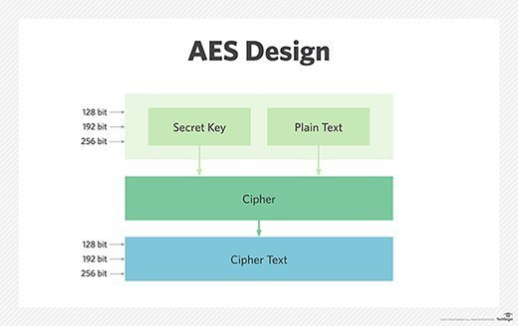
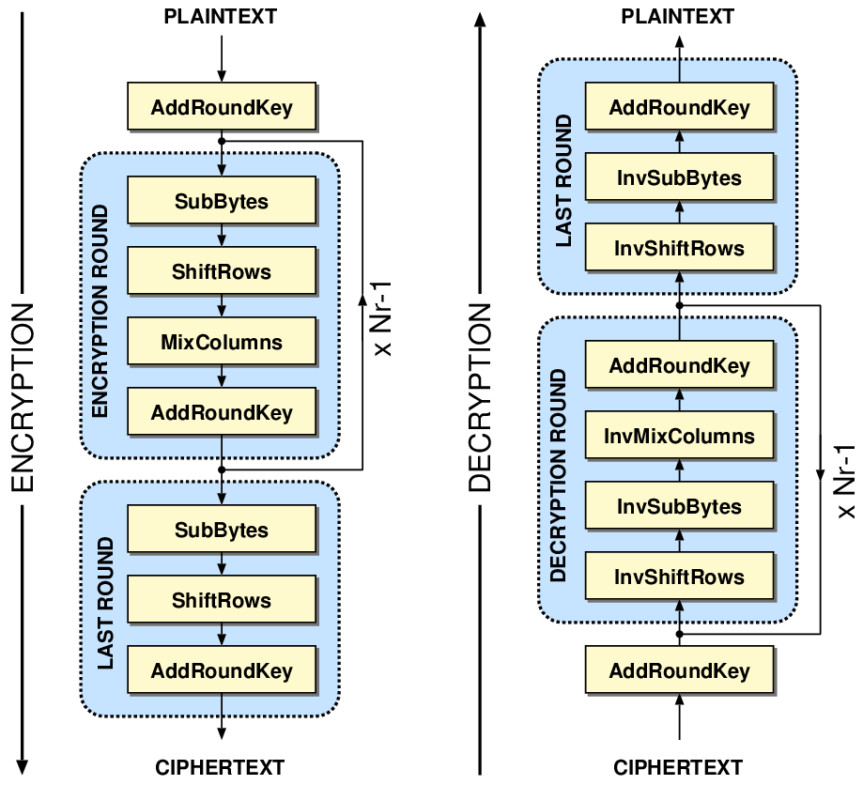
20ECPJ801
220ECPJ801-PP2
Advanced Encryption Standard (AES)
AES is a type of cryptography algorithm.
It performs the encryption and decryption operation. The input information is known as plaintext and encrypted form is called as ciphertext.
Ciphertext contains the plaintext information, but it is not in a readable form to humans. Encryption procedure is varied to one algorithm to another algorithm. Without the key ciphertext cannot be used to encrypt or decrypt.
AES has proven to be more efficient than its encryption processors. AES is mainly used in voice communication, network applications, vertical private network, secured socket layer (SSL)
2

Slide 13
20ECPJ801
220ECPJ801-PP2
TYPES OF AES Algorithm
 | AES 128 | AES 192 | AES256
SPEED | Faster | Approximately 5 times slower than 128 Bit. | Approximately 6 times slower than 128 Bit.
ROUND | 10 | 12 | 14
EFFICIENY | Efficient | More Efficient | Most Efficient
KEY LENGTH | 128 bits | 192 bits | 256 bits
NO OF BLOCK SIZE | 4 | 4 | 4
POSSIBLE COMBINATION | 3.4 * (10 ^ 38) | 6.2 * (10 ^ 57) | 1.1 * (10 ^ 77)
2

Slide 14
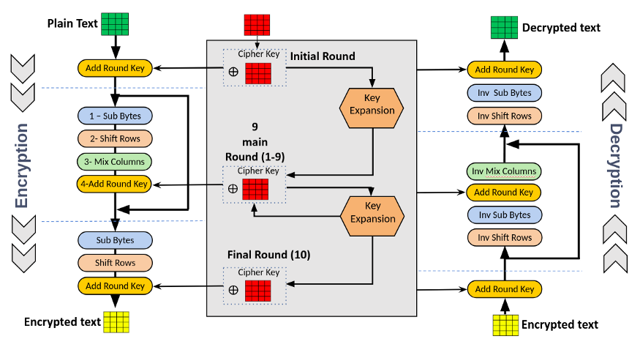
20ECPJ801
220ECPJ801-PP2
BLOCK DIAGRAM OF AES
2

Slide 15
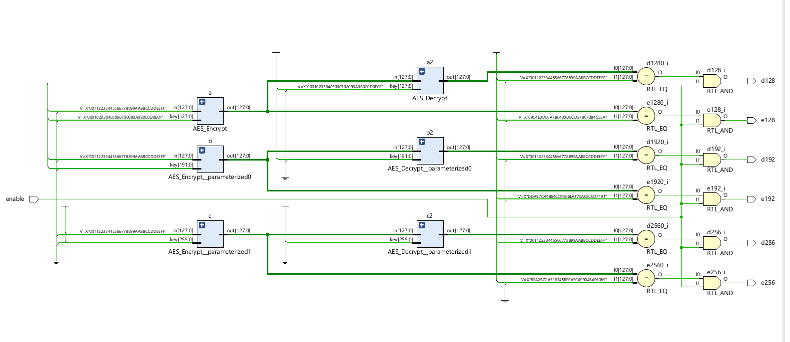
20ECPJ801
220ECPJ801-PP2
BLOCK DIAGRAM OF OUR PROJECT
2

Slide 16
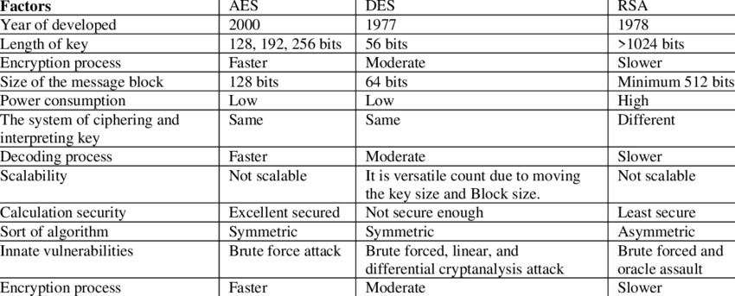
20ECPJ801
220ECPJ801-PP2
AES VS DES VS RSA
2

Slide 17
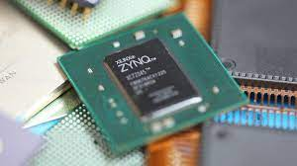
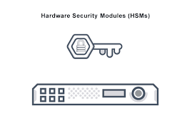
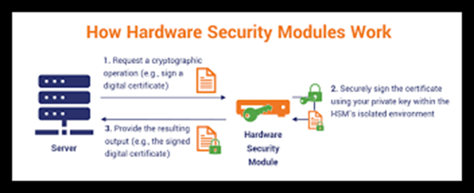
20ECPJ801
220ECPJ801-PP2
HARDWARE SECURITY MODULE
A hardware security module (HSM) is a physical computing device that safeguards and manages digital keys, performs encryption and decryption functions for digital signatures, strong authentication and other cryptographic functions.
These modules traditionally come in the form of a plug-in card or an external device that attaches directly to a computer or network server.
A hardware security module contains one or more secure crypto processor chips
2

Slide 18
20ECPJ801
220ECPJ801-PP2
PROJECT TIMELINE
PHASE 1
Understanding and researching the basics of cryptography, the AES Encryption method, hardware security, and Vivado software constitutes phase 1 of the project. By the end of Fifth Semester all of these research studies will be finished.
2
Once the aforementioned phase's research has been completed. For these algorithms (AES-128, AES-192, and AES-256), we would create programs in HDL or Verilog and undertake case studies to analyze the outcomes.
All of these case studies regarding the results will be completed by the end of the sixth semester.
PHASE 2

Slide 19
20ECPJ801
220ECPJ801-PP2
PHASE
3
once case studies on the effects of the HDL programs we had developed in earlier stages had been completed.
The advantages and disadvantages of the encryption algorithm would be listed. In order to correct it, we would employ deep learning and other ideas to improve the system's security and effectiveness in comparison to the AES technique.
By the end of the seventh semester, the algorithm update will have been finished.
2
After completing of the phase 3 module, now we would check any one of the parameters (Power Consumption or speed or time delay etc.)
A small change is recorded so that we have created a new system from the existing one.
The Project's objective will have been achieved.
This is going to be finished by the conclusion of the Eighth semester.
PHASE
4

Slide 20
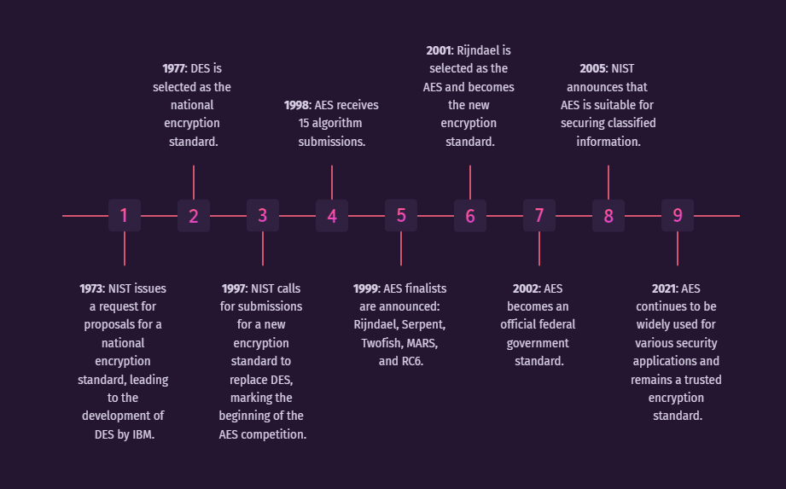
20ECPJ801
220ECPJ801-PP2
TIMELINE OF PROJECT
PHASE 1 (COMPLETED ON 20 DECEMBER 2022)
PHASE 2 (COMPLETED ON 30 MAY 2023)
PHASE 3 (COMPLETED ON 30 NOVEMBER 2023)
PHASE 4 (WILL BE COMPLETED BY END OF MARCH 2024)
2

Slide 21
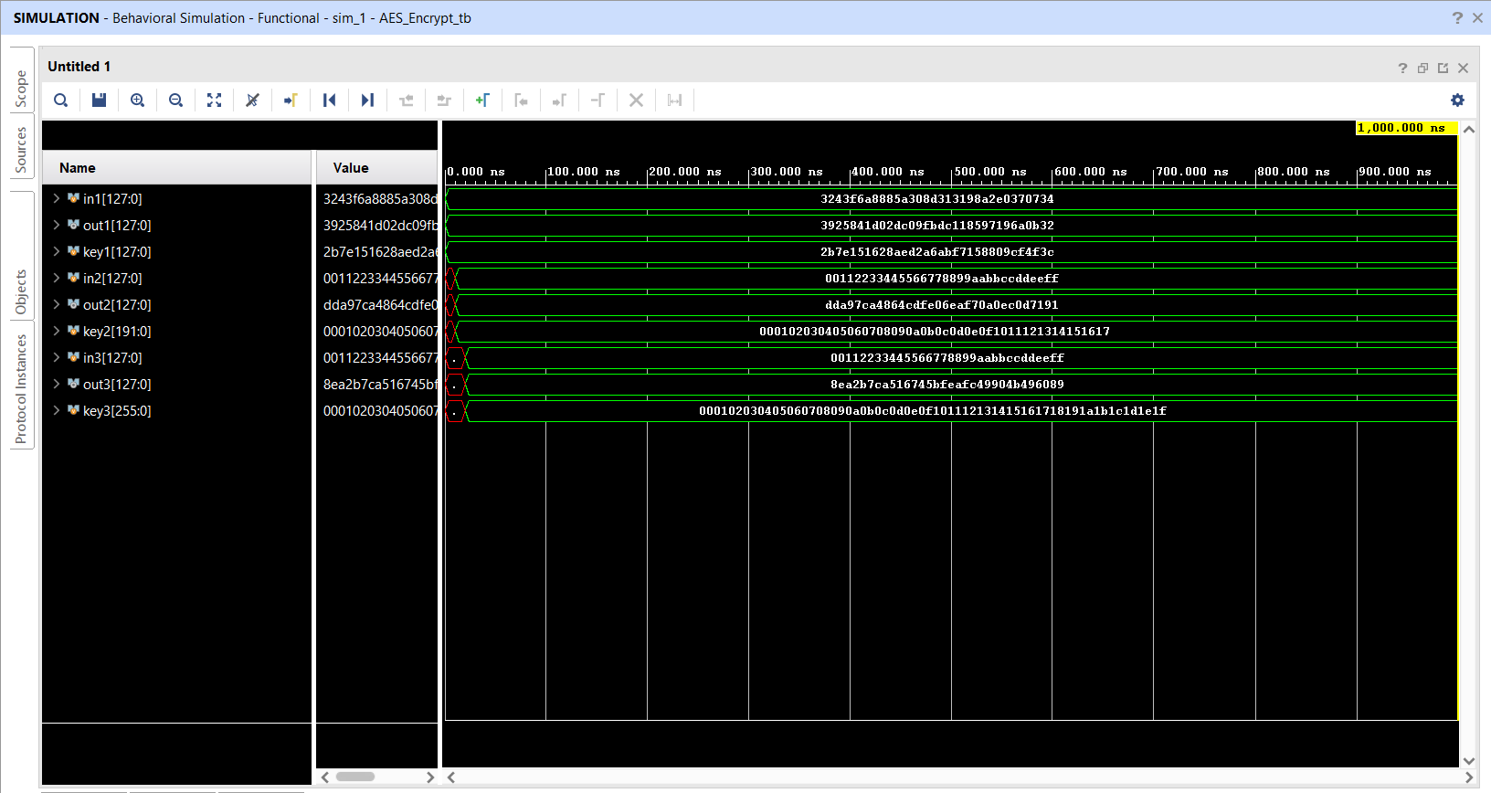
20ECPJ801
220ECPJ801-PP2
OUTPUT
(AES Encryption )
2

Slide 22
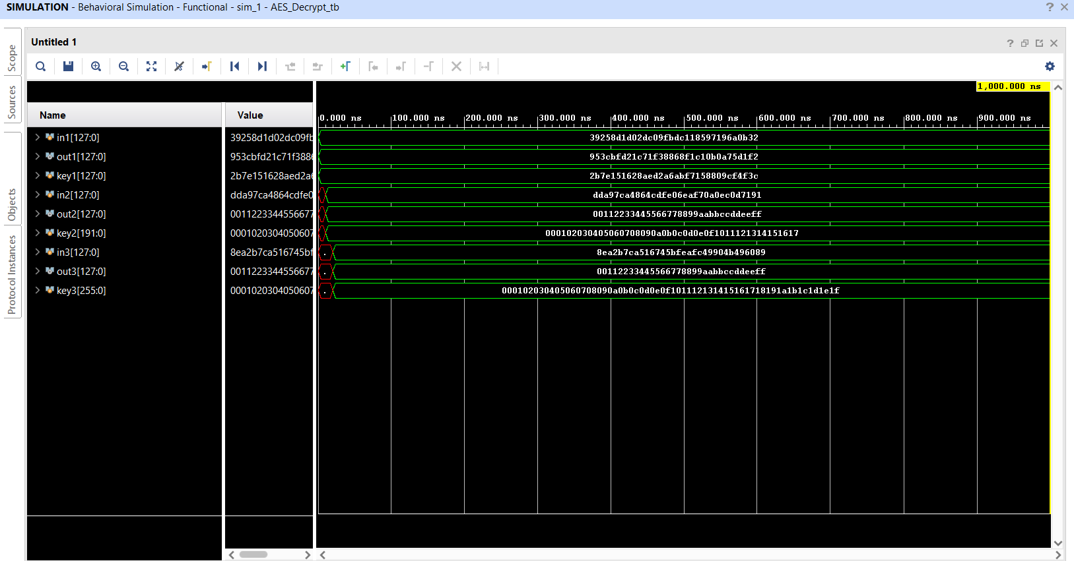
20ECPJ801
220ECPJ801-PP2
OUTPUT
( AES Decryption)
2

Slide 23
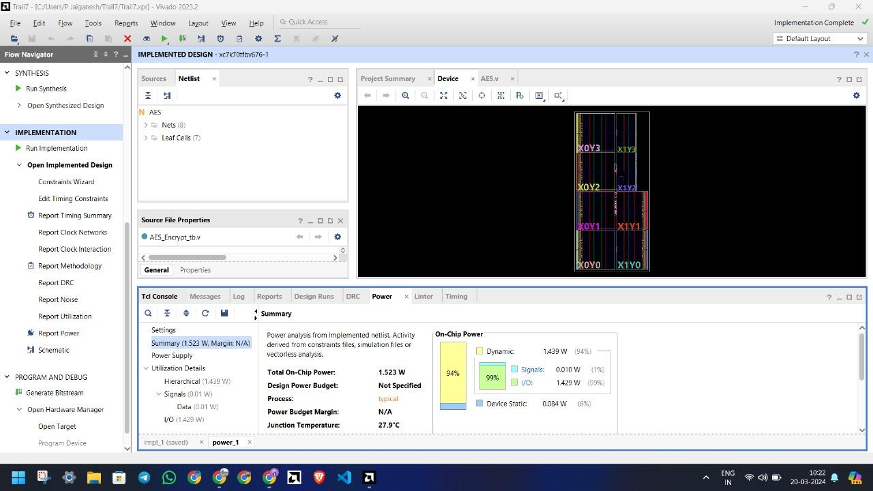
20ECPJ801
220ECPJ801-PP2
POWER ANALYSIS
2

Slide 24
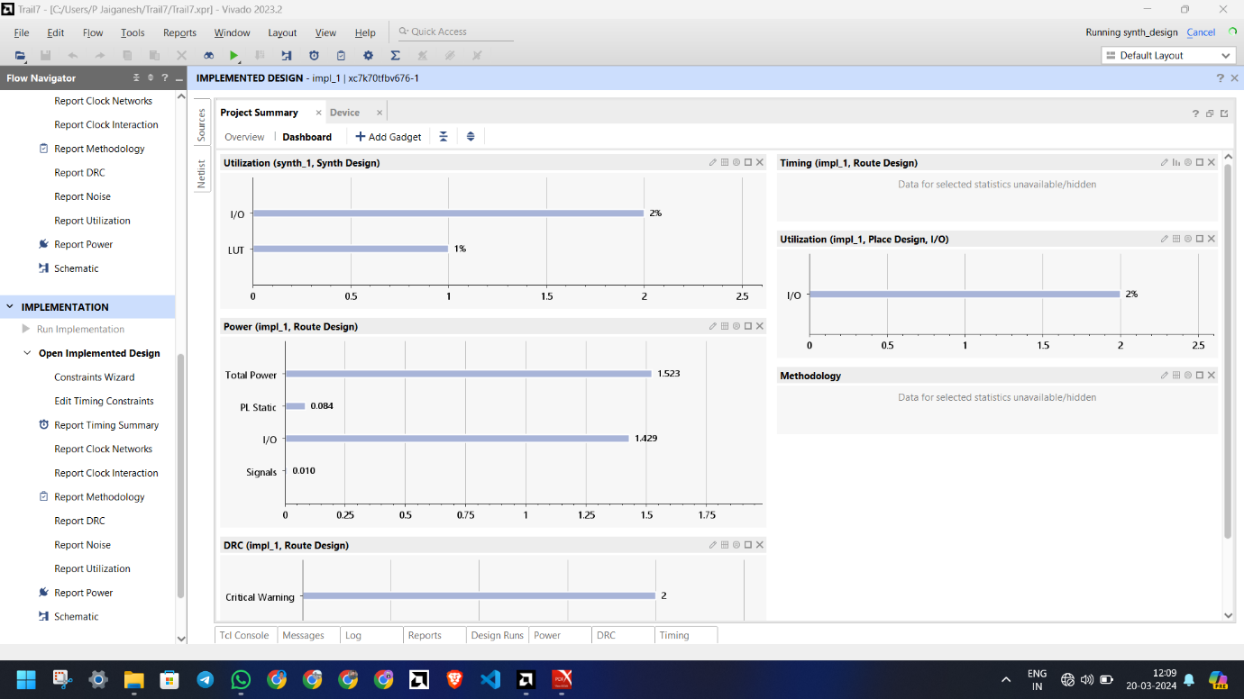
20ECPJ801
220ECPJ801-PP2
LUT ANALYSIS
2

Slide 25
20ECPJ801
220ECPJ801-PP2
CONCLUSION
In Our Project we have reduced the static power consumption 2% from the existing work (8% to 6%) by combing all the AES (128,192 & 256 bits) into a single code .
This lead to best power consumption in this research paper. this is improved algorithm from the existing algorithm and AES encryption is the finest encryption among RSA, DES, and AES, as we have learned by studying encryption techniques.
This leads us to the conclusion that using parallel processing and multiple encryption we have simulated a secure module with less power consumption.
2

Slide 26


20ECPJ801
220ECPJ801-PP2
FUTURE SCOPE
We intended to enhance this project through IOT applications which can
embedded with the PLCs for the industrial applications And also, we can use this in
military applications.
2

Slide 27
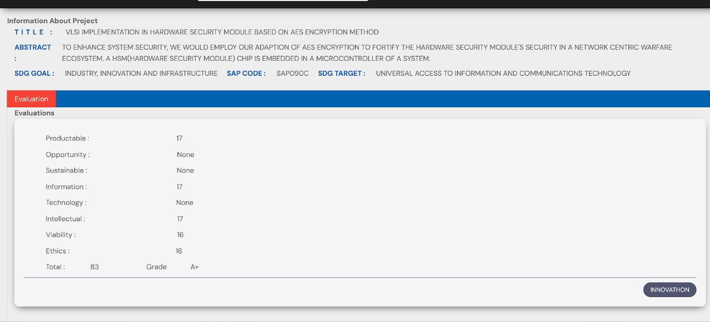
20ECPJ801
220ECPJ801-PP2
Verification of Innovation Ecosystem Portal
2

Slide 28
20ECPJ801
220ECPJ801-PP2
PROJECT MANAGEMENT- GANTT CHART
WORK | SEPT 22 | OCT22 | NOV 22 | DEC22 | JAN 23 | FEB 23 | MAR 23 | APR 23 | JUL 23 | AUG 23 | SEPT 23
PROJECT APPROVAL
LIT REVIEW
SIMULATION
HARDWARE
THESIS
CONTEST
JOURNAL PUBLICATION
2

Slide 29
20ECPJ801
220ECPJ801-PP2
References
Kumar, Pramod, T. V. Narendra, and N. A. Vinay. "Short Hand Recognition using Canny Edge Detector." International Journal 7, no. 5 (2017).
Kumar, Mamatha MS Pramod, and M.Mamatha. "FPGA Implementation Of Low Area Single Precision Floating Point Multiplier."International Journal of Science Technology and Engineering, Vol.2, no. 2 (2016): 560-566.
M.Natheera Banu, FPGA Based Hardware Implementation of Encryption Algorithm, International Journal of Engineering and Advanced Technology (IJEAT) ISSN: 2249 8958, Volume-3, Issue-4, April 2014.
Deguang Le, Jinyi Chang , Xingdou Gou , Ankang Zhang ,Conglan Lu ,Parallel AES Algorithm for Fast Data Encryption on GPU, IEEE journal on AES 2010.
K. Xinmiao Zhang, High speed VLSI architectures for the AES algorithm ,IEEE transactions on VLSI systems, Tech. Rep., sep2004.
National Institute of Standards and Technology, Advanced Encryption Standard, Federal Information Processing Standards 197, November 2001.
M.Pitchaiah, Philemon Daniel, Praveen, Implementation of Advanced Encryption Standard Algorithm, International Journal of Scientific Engineering Research.
2

Slide 30
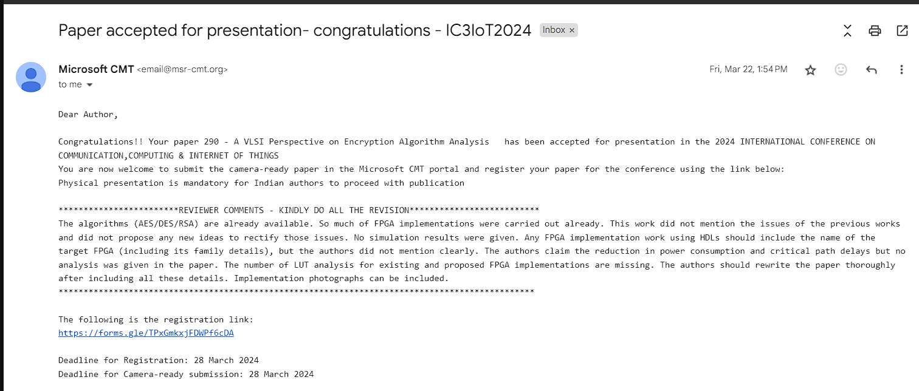
20ECPJ801
220ECPJ801-PP2
PAPER PUBLICATIONS
2

Slide 31
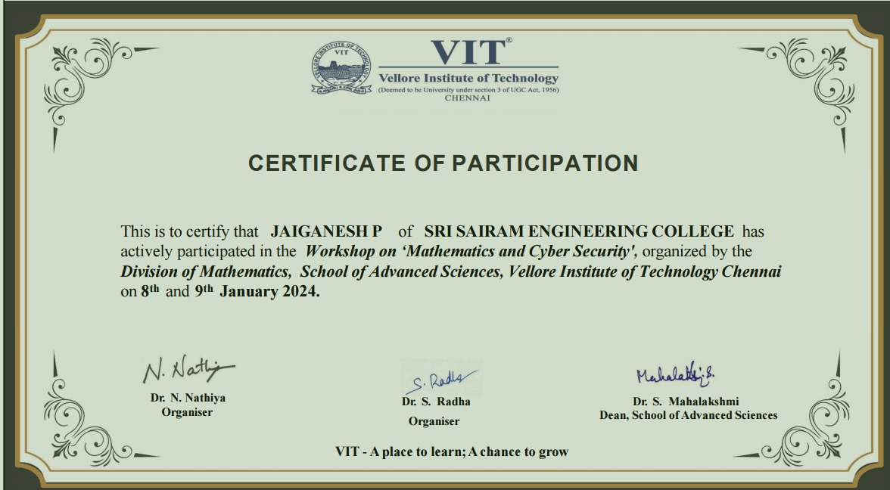
20ECPJ801
220ECPJ801-PP2
PROJECT RELATED COURSES
2

Slide 32
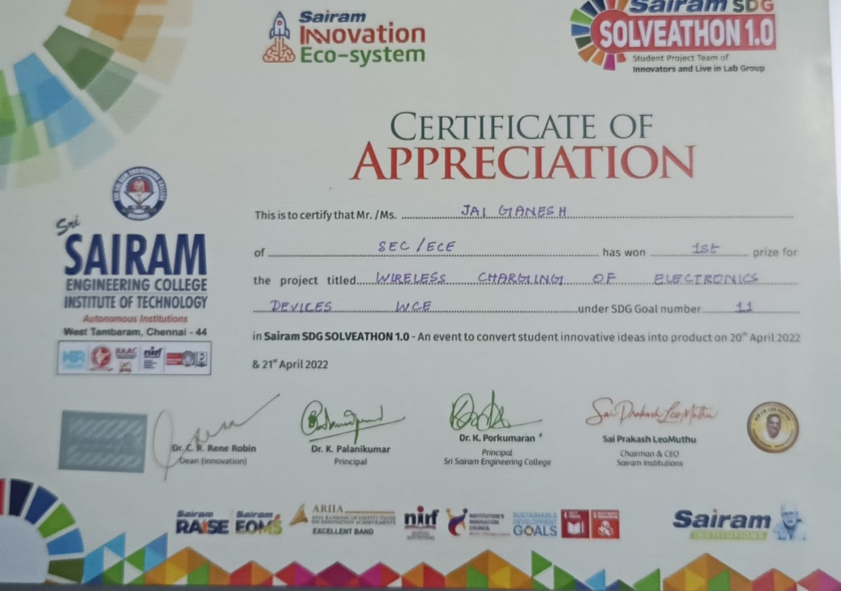
20ECPJ801
220ECPJ801-PP2
ACHIEVEMENTS
2

Slide 33

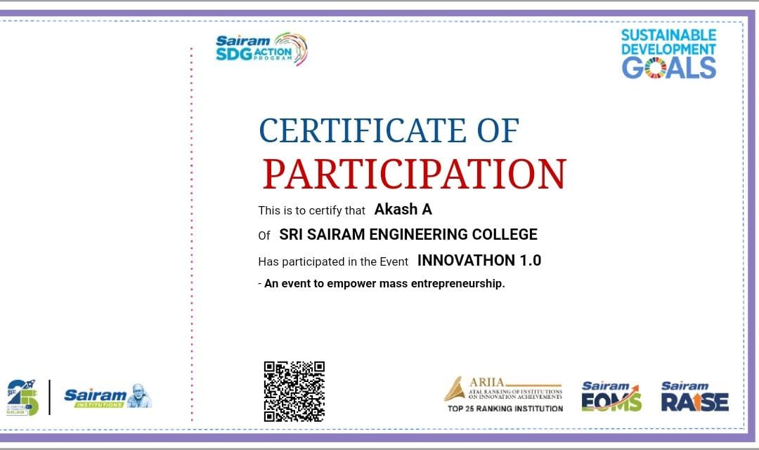
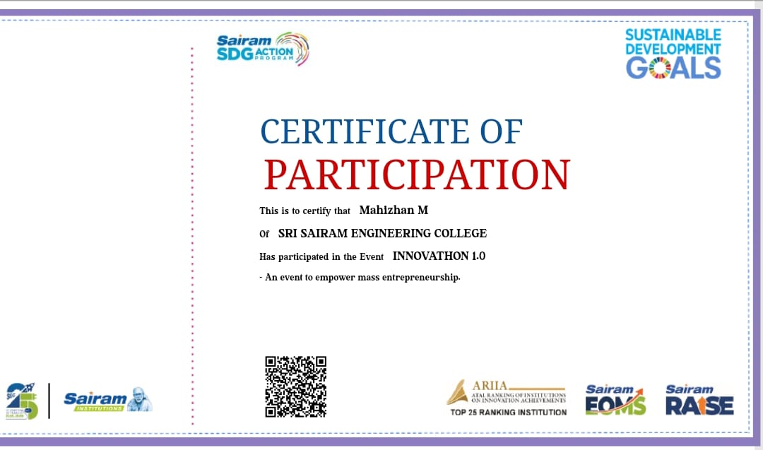
20ECPJ801
220ECPJ801-PP2
ACHIEVEMENTS
2

Slide 34
20ECPJ801
220ECPJ801-PP2
2

